Slide 1
SEMI-SUPERVISED CLASSIFICATION with GRAPH CONVOLUTIONAL NETWORKS (GCN)
ICLR 2017
Yurim Lee
MLV Lab Intern GNN Study

Slide 2
Abstract
We present a scalable approach for semi-supervised learning on graph-structured data that is based on an efficient variant of convolutional neural networks which operate directly on graphs. We motivate the choice of our convolutional architecture via a localized first-order approximation of spectral graph convolutions. Our model scales linearly in the number of graph edges and learns hidden layer representations that encode both local graph structure and features of nodes. In a number of experiments on citation networks and on a knowledge graph dataset we demonstrate that our approach outperforms related methods by a significant margin

Slide 3
1. Introduction
Weighing Factor
Unnormalized Graph Laplacian
Node’s Feature Vector
Labeled Node’s Supervised Loss
Assumption:
connected nodes in the graph are likely to share the same label
Node similarity가 아닌 다른 정보 contain 가능!

Slide 4
1. Introduction
Propose a simple and well-behaved layer-wise propagation rule for neural network models which operate directly on graphs and show how it can be motivated from a first-order approximation of spectral graph convolutions
we demonstrate how this form of a graph-based neural network model can be used for fast and scalable semi-supervised classification of nodes in a graph.

Slide 5

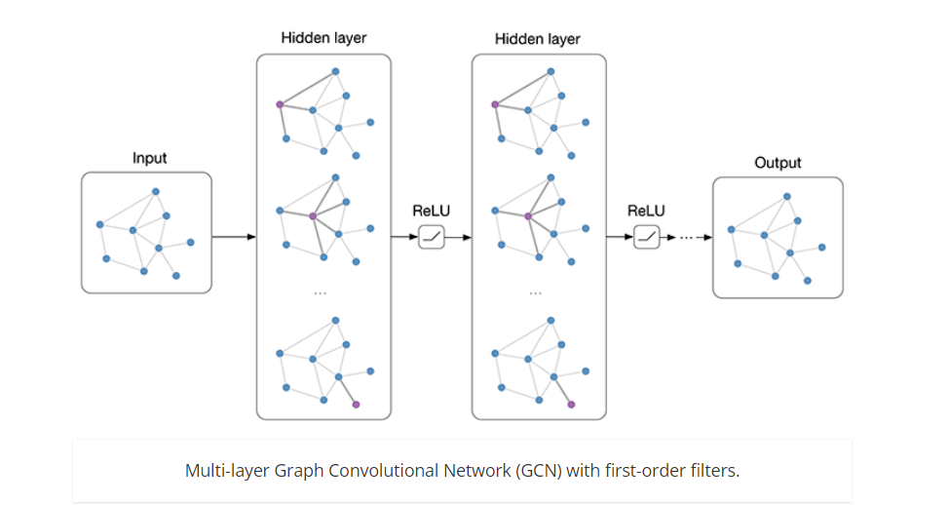
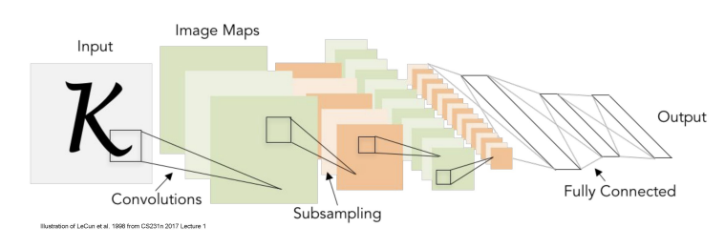
What is GCN?
GRAPH
GCN
+
CNN

Slide 6
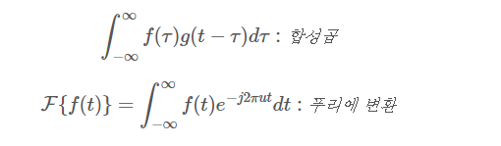

What is GCN?
Fourier Transform:
Signal -> Frequency
Graph Fourier Transform:
Node Feature -> Gap between Features
Frequency가 낮을수록 Node Similarity 높음
Convolution Theorem
두 함수 f, g의 합성곱의 Fourier Transform = f의 Fourier Transform x g의 Fourier Transform

Slide 7
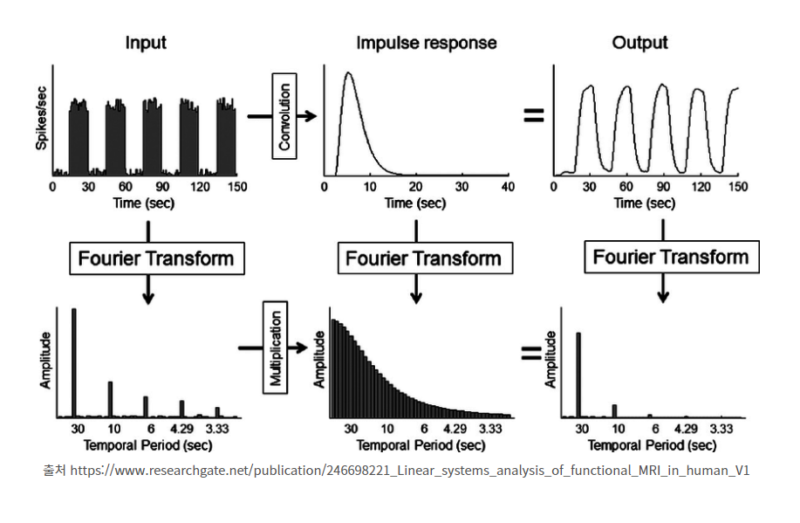
What is GCN?
Convolution Theorem

Slide 8
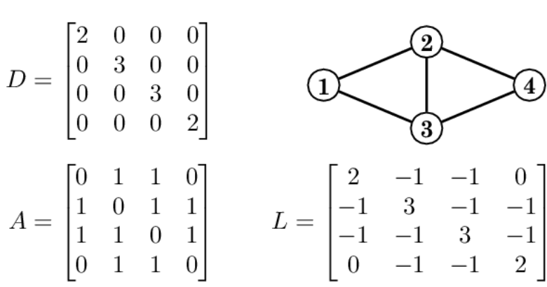
2.1 SPECTRAL GRAPH CONVOLUTIONS
Laplacian Matrix = D - A
How many?
How many & Which?
Which?
Node feature Vector x Laplacian = Gap between Central & Neighborhood

Slide 9
2. FAST APPROXIMATE CONVOLUTIONS ON GRAPHS
Lth layer Actiavation
Adjacency Matrix + self-connection
layer-specific trainable weight matrix

Slide 10


2.1 SPECTRAL GRAPH CONVOLUTIONS
eigenvalue matrix
Signal
eigenvector matrix
Filter
Fourier Transform
gθ = diag(θ) = function of eigenvalues of L= filter
x = node feature vector = signal
U = Laplacian Eigenvector matrix
Time Complexity: O(N^2)

Slide 11




2.1 SPECTRAL GRAPH CONVOLUTIONS
Chebyshev polynomial:
Tk(x) = 2xTk−1(x) − Tk−2(x), with T0(x) = 1 and T1(x) = x
vector of Chebyshev coefficients
Time Complexity: O(|E|)
Why Chebyshev?
수렴 속도 & 근사 오차 감소
범위 제한으로 인한 수치 안정성
Kth-order neighborhood

Slide 12



2.2 LAYER-WISE LINEAR MODEL
K = 1
gradient vanishing/exploding -> Renormalization

Slide 13

2.1 SPECTRAL GRAPH CONVOLUTIONS
convolved signal matrix
matrix of filter parameters
Time Complexity: O(|E|F C)
C input channels
F filters or feature maps

Slide 14

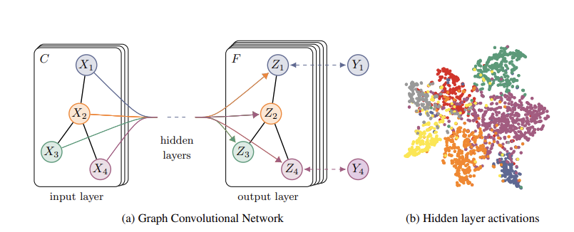
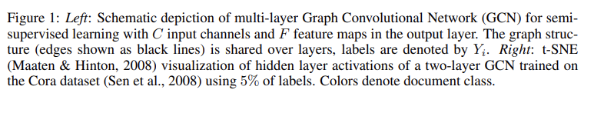
3. SEMI-SUPERVISED NODE CLASSIFICATION
Input-to-hidden
Hidden-to-output

Slide 15

3. SEMI-SUPERVISED NODE CLASSIFICATION
set of node indices that have labels
- batch gradient descent
- sparse representation -> Memory
- dropout

Slide 16
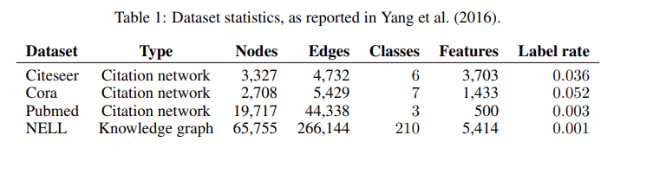
5. Experiments
Dataset
Citeseer, Cora, Pubmed (Undirected)
Node: Document (bag-of-words feature vectors)
Edge: Citation link
Label rate: labeled nodes/total nodes
NELL (Knowledge Graph, Directed)
Node: Entity
Edge: Relation

Slide 17
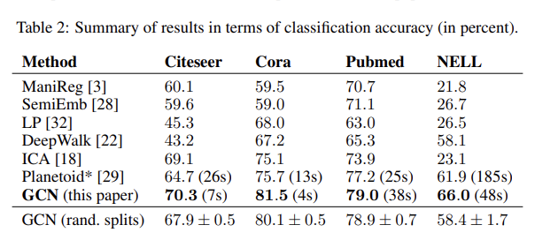
6. Results

Slide 18
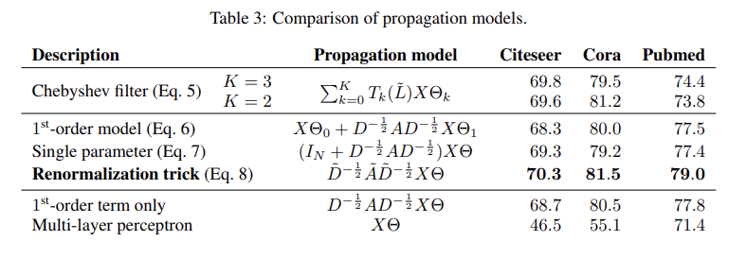
6. Results

Slide 19
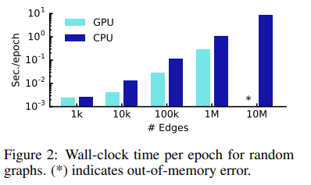
6. Results

Slide 20

7. Limitations
Memory requirement
Full Batch Gradient Descent -> Mini Batch
Directed edges and edge features
Limited to Undirected Graph.
But, in the case of NELL
directed edges & edge features -> undirected bipartite graph with additional nodes
Limiting assumptions
self-connections = edges to neighboring nodes ->

Slide 21
Thank you!

